Slide 1
Isotopes

Slide 2
aims
Learning intentions:
We will learn about isotopes and some of their properties
Success criteria:
We will be able to describe how neutrons and isotopes are related
We will be able to predict if a nucleus will be stable
We will be able to write isotopes using symbols and words
We will be able to list some of the applications of radioactivity, including to sustainable energy, medicine, and in dating fossils

Slide 3
Atomic mass
On the periodic table, elements are listed with a decimal mass, but that would mean that we don’t have whole numbers of neutrons. (eg, chlorine has an atomic mass of 35.453, which would mean a neutron has been cut in half!)
The reason for the decimal masses is that different atoms have different numbers of isotopes. For example, approximately 99% of all carbon atoms have 6 neutrons, but 1% of all carbon atoms have 7 neutrons
The numbers we see on the periodic table are a weighted average based on the different isotopes

Slide 4
What do neutrons do?
Hold the nucleus of an atom together, like a glue. This is known as an increase in the “binding” energy
If there’s not enough neutrons, the protons will repel each other, making the nucleus unstable
If there’s too many neutrons, the atom has far too much energy, and will want to release that energy, making the nucleus unstable
Otherwise, the nucleus is stable. We will explore this more in our upcoming investigation

Slide 5
Naming isotopes
Two ways of writing – depends on if you want to write the full name or just the chemical symbol. Both use the mass number, not the number of neutrons, in their name
For carbon with 6 neutrons and 6 protons:
Carbon-12
¹²C
For carbon with 7 neutrons and 6 protons:
Carbon-13
¹³C

Slide 6
CFU #1
An isotope is an atom with…
A different number of protons
A different number of neutrons
A different number of electrons
A charge
End
1
2
3
4
5
6
7
8
9
10
11
12
13
14
15
16
17
18
19
20
21
22
23
24
25
26
27
28
29
30

Slide 7
CFU #2
Nitrogen-14 has 7 protons and how many neutrons?
End
1
2
3
4
5
6
7
8
9
10
11
12
13
14
15
16
17
18
19
20
21
22
23
24
25
26
27
28
29
30

Slide 8
CFU #3
What would be the correct isotope symbol for hydrogen-3?
₃H
³H
H³
H₃
End
1
2
3
4
5
6
7
8
9
10
11
12
13
14
15
16
17
18
19
20
21
22
23
24
25
26
27
28
29
30

Slide 9
radioactivity
Radioactivity arises when a nucleus is unstable and wants to stabilise itself
To stabilise itself, the nucleus will remove particles from itself, forming entirely different species
Isotopes that exhibit radioactivity are referred to as “radioisotopes”.

Slide 10
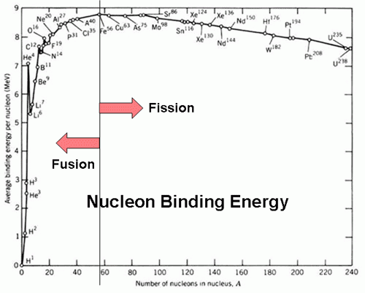
Nuclear energy
Theorised to be one of the most sustainable forms of energy. Involves the “fusing” (fusion) of atomic nuclei to form bigger atoms, followed by the “splitting” (fission) of atomic nuclei to form smaller atoms

Slide 11
Nuclear medicine
Involves the use of radioisotopes in the diagnosis and treatment of patients. “Radiation therapy” as a cure to cancer has been made famous by many TV dramas and even sitcoms
More useful applications are in radioimaging, in which radioactivity of a sample (called a tracer dye) in the body is measured, allowing us to create a 3D image of a part of the patient. Most common form is PET (positron emission topography)

Slide 12
Radiocarbon dating
An application we will be looking into with a bit more detail next week, when we’ve learned a little bit more about radioactivity
Basically, all living things, and things that were once living, contain carbon, and a certain proportion of that carbon is radioactive carbon-14
We know how to exactly calculate how long it takes for radioisotopes to decay
We can combine the two to find out how old fossils are

Slide 13
aims
Learning intentions:
We will learn about isotopes and some of their properties
Success criteria:
We will be able to describe how neutrons and isotopes are related
We will be able to predict if a nucleus will be stable
We will be able to write isotopes using symbols and words
We will be able to list some of the applications of radioactivity, including to sustainable energy, medicine, and in dating fossils

Slide 14
Exit ticket
Name:
Isotopes are atoms with a different number of ___________.
Write the name for each isotope: Write the symbol for each isotope:
¹³C Nitrogen-15
⁴He Hydrogen-3
⁶⁰Fe Copper-63

